Slide 1
Group 3
Ahmad Danial Izzat
Nur Aina
Van Tze Shan
Hazman Syahmi

Slide 2
Loan Status(Yes or No) depends on Credit History, Loan Amount to Income Gap and Dependents. Suggestion to reconsider to reduce approving loan to an applicant with bad credit history.

Slide 3
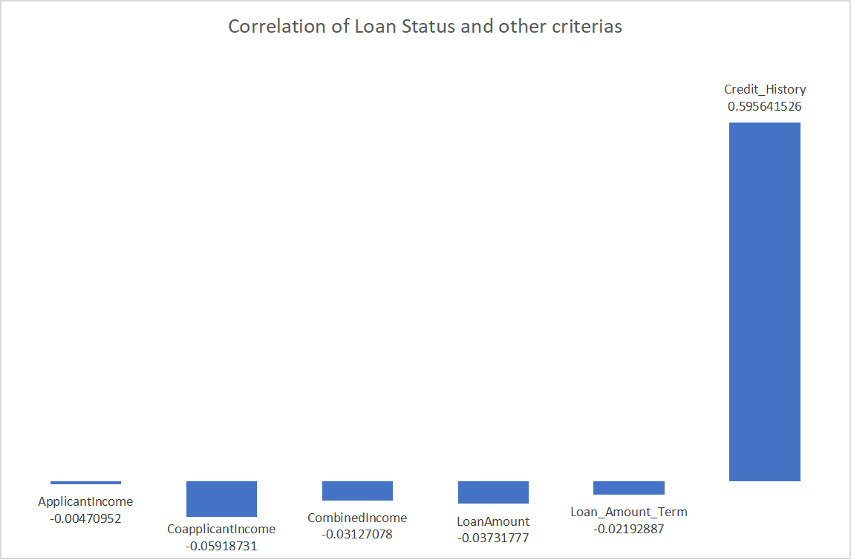

Slide 4
Loan Default issue was mainly caused by Loan Amount to Income Gap. High Loan Amount to Income Gap tend to lead to a Loan Default. For reducing or get rid of Loan Default in the future, advisable for the bank need to approve loans with lower Loan Amount to Income Gap.

